Slide 1
Semantic Data Mining
Tutorial at ECML/PKDD 2011
Athens
September 9, 2011

Slide 2
Tutorial overview
Part 1: Introduction to Semantic Data Mining (SDM)
Nada Lavrac, Anze Vavpetic
Jozef Stefan Institute, Ljubljana, Slovenia
Part 2: Learning from Description Logics (DL‑learning)
Agnieszka Lawrynowicz, Jedrzej Potoniec
Poznan University of Technology, Poznan, Poland
Part 3: Semantic meta-mining
Melanie Hilario, Alexandros Kalousis
University of Geneva, Geneva, Switzerland

Slide 3
Overview of Part 1
Introduction to Semantic Data Mining (SDM)
Nada Lavrac
  Background and motivation
  What is Semantic Data Mining: Definition and settings
  Early work in Semantic subgroup discovery
Anze Vavpetic
  …

Slide 4
Background and motivation: Data mining
knowledge discovery from data
Data Mining
model, patterns, …
data
  Given: transaction data table, a set of text documents, …
  Find: a classification model, a set of interesting patterns

Slide 5
Background and motivation: Using BK in data mining
Using background knowledge in data mining has been a topic of extensive research
  Hierarchical attribute values (Michalski et al. 1986,…), hierarchy/taxonomy of attributes, …
  ILP (Muggleton, 1991; Lavrac and Dzeroski 1994), relational learning (Quinlan, 1993), propositionalization (Lavrac et al. 1993), …

Slide 6
Background and motivation: Relational data mining
Relational Data Mining
knowledge discovery from data
model, patterns, …
  Given: a relational database, a set of tables, sets of logical
  facts, a graph, …
  Find: a classification model, a set of patterns

Slide 7
Background and motivation: Relational data mining
ILP, relational learning, propositionalization
  Learning from complex multi-relational data

Slide 8
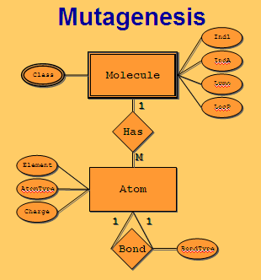
Background and motivation: Relational data mining
ILP, relational learning, propositionalization
  Learning from complex multi-relational data
  Learning from complex structured data: e.g., molecules and their properties in protein engineering, biochemistry, ...

Slide 9
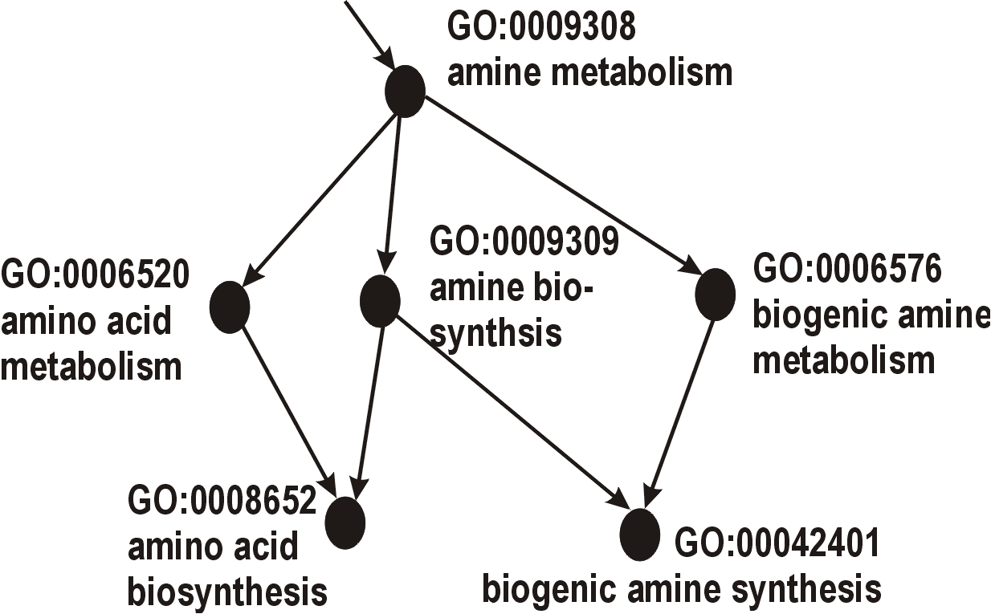
Background and motivation: Relational data mining
ILP, relational learning, propositionalization
  Learning from complex multi-relational data
  Learning from complex structured data: e.g., molecules and their properties in protein engineering, biochemistry, ...
  Learning by using domain ontologies (e.g. the gene ontology) as background knowledge for relational data mining

Slide 10
Background and motivation: Using domain ontologies
Using domain ontologies as background knowledge
E.g., the Gene Ontology (GO)
GO is a database of terms, describing gene sets in terms of their
  functions (12,093)
  processes (1,812)
  components (7,459)
Genes are annotated
  to GO terms
Terms are connected
  (is_a, part_of)
Levels represent
  terms generality

Slide 11
Background and motivation: Using domain ontologies
Using background knowledge in data mining has been a topic of extensive research
  Hierarchical attribute values, hierarchy/taxonomy of attributes, since 1986
  ILP, relational data mining, propositionalization, since 1991
  Ontologies (Tim Berners-Lee), since 1989
    accepted formalism for consensual knowledge representation for Semantic Web applications, a basic for the Semantic Web
    Description logic, OWL, Protégé ontology editor
  Using ontologies in data mining, since 2004

Slide 12
  Background and motivation: Early work
  Inducing Multi-Level Association Rules from Multiple Relations (F.A. Lisi and D. Malerba, MLJ 2004)
  Mining the Semantic Web: A Logic-Based Methodology (F.A. Lisi and F. Esposito, ISMIS, 2005)
  using an engineering ontology of CAD elements and structures as BK to extract frequent product design patterns in CAD repositories and discovering predictive rules from CAD data (Zakova et al., ILP 2006)
  using biomedical ontologies as BK in microarray data analysis for finding groups of differentially expressed genes (Zelezny et al., Biomed, 2006)
  Data Mining with Ontologies: Implementations, Findings, and Frameworks, edited by H.O. Nigro, S.G. Cisaro, D. Xodo, Information Science reference, 2008

Slide 13
What is Semantic Data Mining
Ontology-driven (semantic) data mining is an emerging research topic – the topic of this tutorial
Semantic Data Mining (SDM) - a new term denoting:
  the new challenge of mining semantically annotated resources, with ontologies used as background knowledge to data mining
  approaches with which semantic data are mined

Slide 14
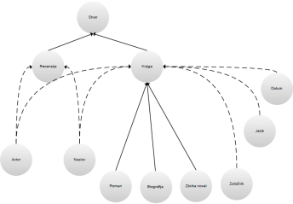
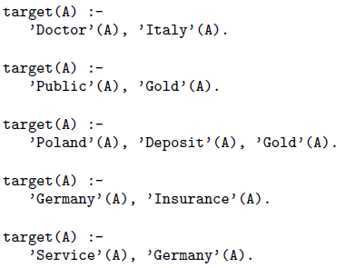
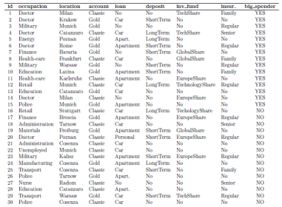
What is Semantic Data Mining
SDM task definition
ontologies
Semantic
data mining
model,
patterns
annotations,
mappings
  Given:
  transaction data table, relational database, text documents, Web pages, …
  one or more domain ontologies
  Find: a classification model, a set of patterns
data

Slide 15
  What is Semantic Data Mining
Current Semantic data mining scenario: Mining empirical data with ontologies as background knowledge
    abundant empirical data, but
    scarce background knowledge
Future Semantic data mining scenario:
  envisioning a growing amount of semantic data
    abundance of ontologies and semantically anotated data collections
    e.g. Linked Data
      over 6 billion RDF triples
      over 148 million links

Slide 16
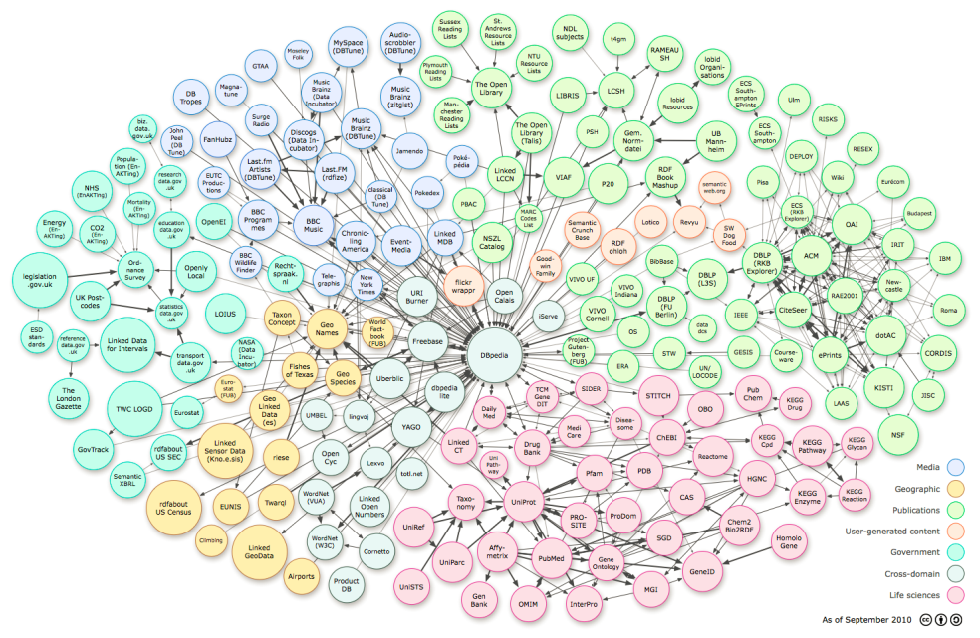
  What is Semantic Data Mining
We may envision a paradigm shift from data mining to knowledge mining
The envisioned future Semantic data mining scenario in mining the Semantic Web:
  mining knowledge encoded in domain ontologies,
  constrained by annotated (empirical) data collections.

Slide 17
What is Semantic Data Mining
Two different types of semantic resources can be exploited in data mining:
  Domain ontologies
    Using domain ontologies as background knowledge (BK) for mining experimental data – see Part 1 of this tutorial
    Mining OWL ontologies and other annotated resources (DL-learning) – see Part 2
  Data mining ontologies
    Developing and using a data mining ontology for meta-mining of data mining workflows – see Part 3

Slide 18
Early work in Semantic subgroup discovery: RSD and SEGS
Part 1a of this tutorial (N. Lavrac) presents two relational subgroup discovery systems, using domain ontologies as background knowledge in Semantic data mining
    General purpose system RSD for Relational Subgroup Discovery, using a propositionalization approach to relational data mining (Zelezny and Lavrac, MLJ 2006)
    Specialized system SEGS for Searching for Enriched Gene Sets, performing top-down search of rules, formed as conjunctions of ontology terms (Trajkovski et al., IEEE TSMC 2008, Trajkovski et al., JBI 2008)
  Part 1b of this tutorial (A. Vavpetic) presents g-SEGS (2010) and SDM-Aleph (2011) by a demo/video

Slide 19
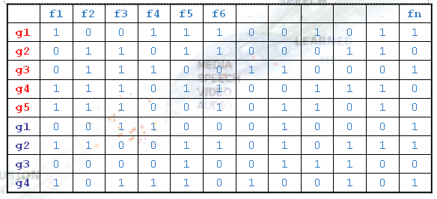
RSD: Propositionalization approach to relational data mining
Propositionalization
Step 1

Slide 20
RSD: Propositionalization approach to data mining
Propositionalization
Step 1
  constructing relational features
  constructing a propositional table

Slide 21
RSD: Propositionalization approach to data mining
Propositionalization
Step 1
  constructing relational features
  constructing a propositional table
Data Mining
Step 2
model, patterns, …

Slide 22
Relational subgroup discovery with RSD
Propositionalization
Step 1
  constructing relational features
  constructing a propositional table
Subgroup discovery
Step 2
patterns (set of rules)

Slide 23
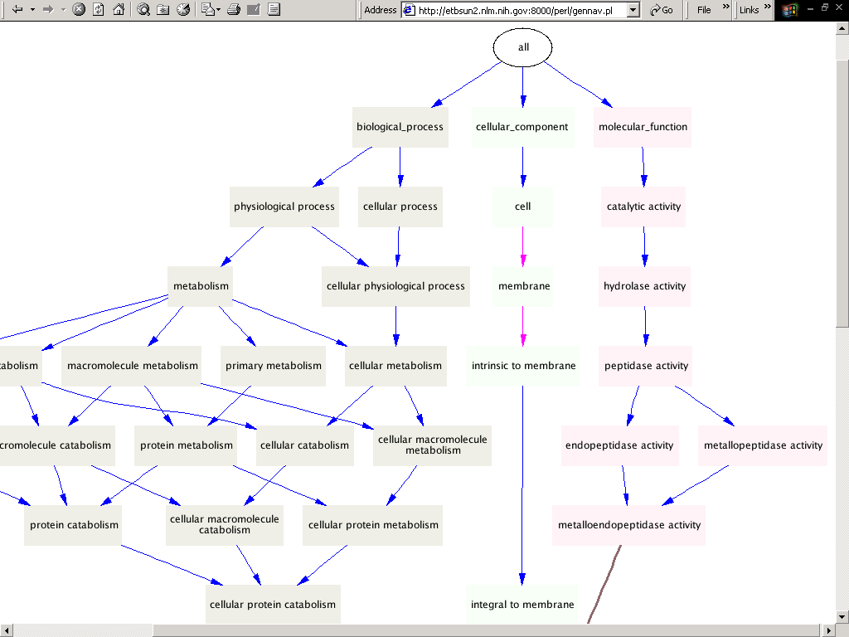
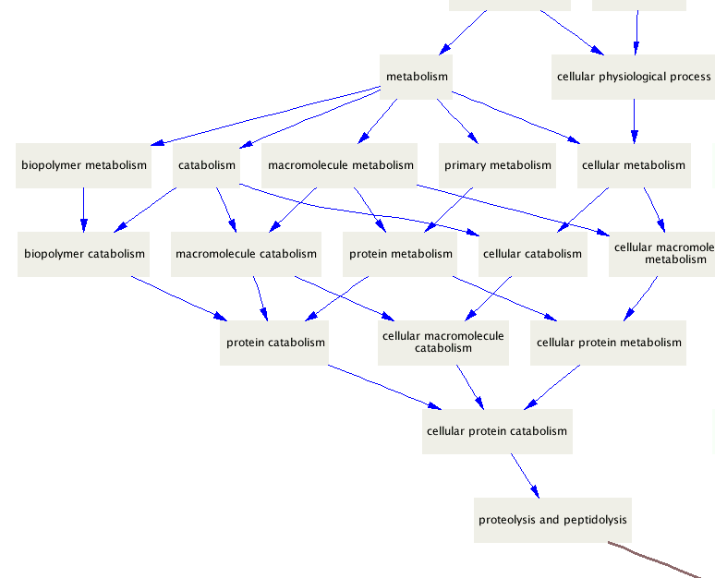
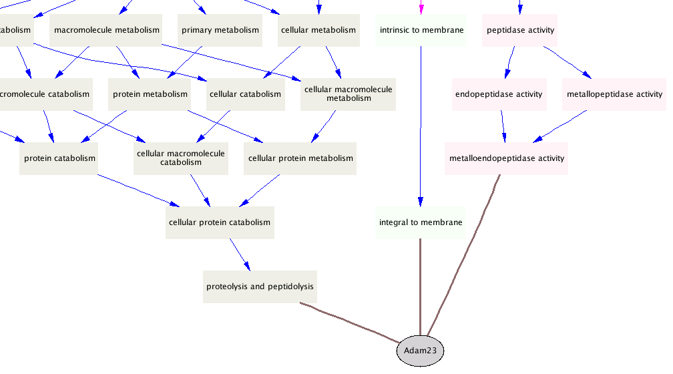
Semantic subgroup discovery with RSD
Using GO as background knowledge in DNA microarray data analysis with relational subgroup discovery system RSD
Gene Ontology
12,093 biological process
1,812 cellular components
7,459 molecular functions
Joint work with F. Zelezny, I. Trajkovski and J. Tolar
(Biomed, 2006)

Slide 24
Semantic subgroup discovery with RSD
Ontology terms (can be viewed as generalisations of individual genes) are described by first-order features, presenting gene properties and relations between genes.

Slide 25
Semantic subgroup discovery with RSD
Application of RSD in microarray data analysis using GO as background knowledge (Zelezny et al., Biomed, 2006)
1. Take ontology terms represented as logical facts, e.g.
component(gene2532,'GO:0016020').
function(gene2534,'GO:0030554').
process(gene2534,'GO:0007243').
interaction(gene2534,gene4803).
2. Automatically generate generalized relational features:
f(2,A):-component(A,'GO:0016020').
f(7,A):-function(A,'GO:0030554').
f(11,A):-process(A,'GO:0007243').
f(224,A):- interaction(A,B),
function(B,'GO:0016787'), component(B,'GO:0043231').
3. Propositionalization: Determine truth values of features
4. Learn rules by a subgroup discovery algorithm CN2-SD

Slide 26
Semantic subgroup discovery with RSD
Construction of first order features with support > min_support
f(7,A):-function(A,'GO:0046872').
f(8,A):-function(A,'GO:0004871').
f(11,A):-process(A,'GO:0007165').
f(14,A):-process(A,'GO:0044267').
f(15,A):-process(A,'GO:0050874').
f(20,A):-function(A,'GO:0004871'), process(A,'GO:0050874').
f(26,A):-component(A,'GO:0016021').
f(29,A):- function(A,'GO:0046872'), component(A,'GO:0016020').
f(122,A):-interaction(A,B),function(B,'GO:0004872').
f(223,A):-interaction(A,B),function(B,'GO:0004871'), process(B,'GO:0009613').
f(224,A):-interaction(A,B),function(B,'GO:0016787'), component(B,'GO:0043231').
existential

Slide 27
RSD: Propositionalization
diffexp g1 (gene64499)
diffexp g2 (gene2534)
diffexp g3 (gene5199)
diffexp g4 (gene1052)
diffexp g5 (gene6036)
….
random g1 (gene7443)
random g2 (gene9221)
random g3 (gene2339)
random g4 (gene9657)
….
 | f1 | f2 | f3 | f4 | f5 | f6 | … |  |  |  | … | fn
g1 | 1 | 0 | 0 | 1 | 1 | 1 | 0 | 0 | 1 | 0 | 1 | 1
g2 | 0 | 1 | 1 | 0 | 1 | 1 | 0 | 0 | 0 | 1 | 1 | 0
g3 | 0 | 1 | 1 | 1 | 0 | 0 | 1 | 1 | 0 | 0 | 0 | 1
g4 | 1 | 1 | 1 | 0 | 1 | 1 | 0 | 0 | 1 | 1 | 1 | 0
g5 | 1 | 1 | 1 | 0 | 0 | 1 | 0 | 1 | 1 | 0 | 1 | 0
g1 | 0 | 0 | 1 | 1 | 0 | 0 | 0 | 1 | 0 | 0 | 0 | 1
g2 | 1 | 1 | 0 | 0 | 1 | 1 | 0 | 1 | 0 | 1 | 1 | 1
g3 | 0 | 0 | 0 | 0 | 1 | 0 | 0 | 1 | 1 | 1 | 0 | 0
g4 | 1 | 0 | 1 | 1 | 1 | 0 | 1 | 0 | 0 | 1 | 0 | 1

Slide 28
RSD: Rule construction with CN2-SD
 | f1 | f2 | f3 | f4 | f5 | f6 | … |  |  |  | … | fn
g1 | 1 | 0 | 0 | 1 | 1 | 1 | 0 | 0 | 1 | 0 | 1 | 1
g2 | 0 | 1 | 1 | 0 | 1 | 1 | 0 | 0 | 0 | 1 | 1 | 0
g3 | 0 | 1 | 1 | 1 | 0 | 0 | 1 | 1 | 0 | 0 | 0 | 1
g4 | 1 | 1 | 1 | 0 | 1 | 1 | 0 | 0 | 1 | 1 | 1 | 0
g5 | 1 | 1 | 1 | 0 | 0 | 1 | 0 | 1 | 1 | 0 | 1 | 0
g1 | 0 | 0 | 1 | 1 | 0 | 0 | 0 | 1 | 0 | 0 | 0 | 1
g2 | 1 | 1 | 0 | 0 | 1 | 1 | 0 | 1 | 0 | 1 | 1 | 1
g3 | 0 | 0 | 0 | 0 | 1 | 0 | 0 | 1 | 1 | 1 | 0 | 0
g4 | 1 | 0 | 1 | 1 | 1 | 0 | 1 | 0 | 0 | 1 | 0 | 1
Over-
expressed
IF
f2 and f3
[4,0]

Slide 29
RSD implementation in Orange4WS
RSD implemented as a workflow in Orange4WS:
  propositionalization
  subgroup discovery algorithms: SD, Apriori-SD, CN2-SD
29

Slide 30
  Semantic subgroup discovery with SEGS
  Gene set enrichment: moving from single gene to gene set analysis
  A gene set is enriched if the genes in the set are statistically significantly differentially expressed compared to the rest of the genes.
  Observation: E.g., an 20% increase in all genes members of a biological pathway may alter the execution of this pathway … and its impact on other processes … significantly more then a 10-fold increase in a single gene.
  System SEGS for finding groups of differentially expressed genes from experimental microarray data
  Using biomedical ontologies GO, KEGG and ENTREZ as background knowledge

Slide 31
Semantic subgroup discovery with SEGS
Gene set enrichment methods:
  Single GO terms:
    Gene Set Enrichment Analysis (GSEA)
    Parametric Analysis of Gene Set Enrichment (PAGE)
  Conjunctions of GO terms: SEGS
Results of Searching for Enriched Gene Sets with SEGS:
  Rules describing groups of genes that are differentially expressed (e.g., belong to class DIFF-EXP of top 300 most differentially expressed genes) in contrast with RANDOM genes (randomly selected genes with low differential expression).
Sample semantic subgroup description:
diffexp(A) :- interaction(A,B) & function(B,'GO:0004871') & process(B,'GO:0009613')

Slide 32
Semantic subgroup discovery with SEGS
The SEGS approach:
  Fuse information from GO, KEGG and ENTREZ
  Generate gene set candidates as conjunctions of GO, KEGG and ENTREZ terms
  Combine Fisher, GSEA and PAGE enrichment tests to select most interesting groups of differentially expressed genes

Slide 33
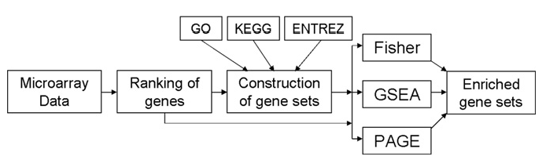
Semantic subgroup discovery with SEGS
SEGS workflow is implemented in the Orange4WS data mining environment
SEGS is also implemented also as a Web applications
    (Trajkovski et al., IEEE TSMC 2008, Trajkovski et al., JBI 2008)

Slide 34
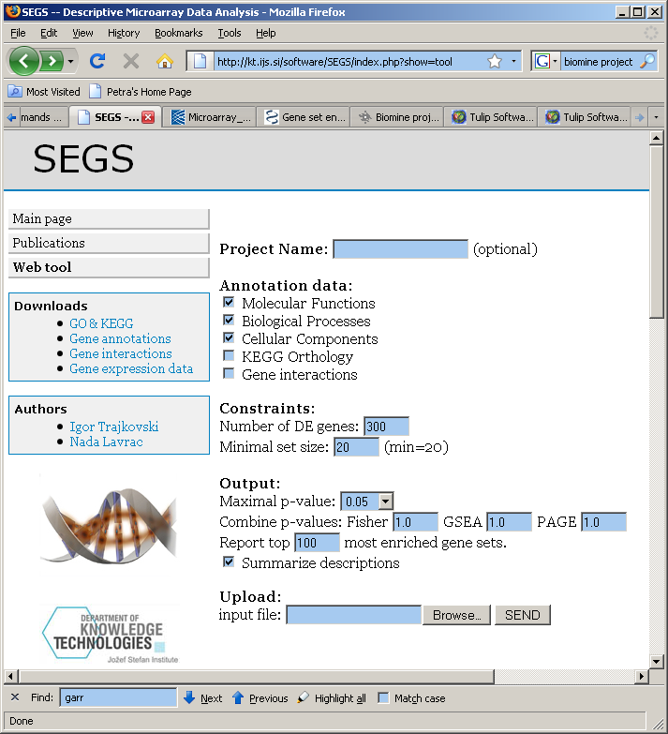
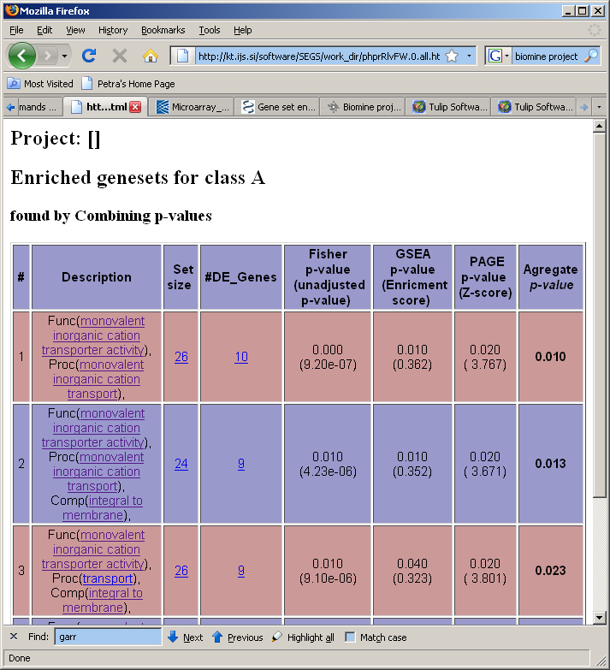
Semantic subgroup discovery with SEGS

Slide 35
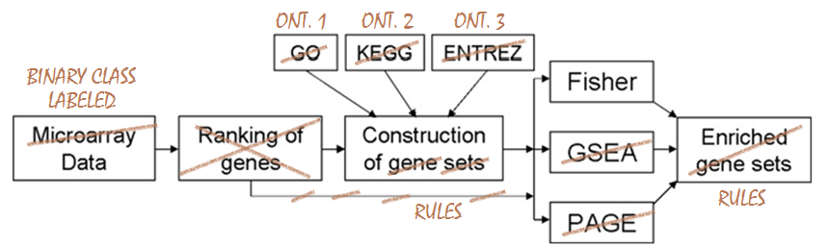
From SEGS to g-SEGS: Generalizing SEGS
g-SEGS: a semantic data mining system generalizing SEGS
Discovers subgroups both for ranked and labeled data
Exploits input ontologies in OWL format
Is also implemented in Orange4WS

Slide 36
  Publications in Semantic subgroup discovery
  M. Zakova, F. Zelezny, J.A. Garcia-Sedano, C. Masia Tissot, N. Lavrac, P. Kremen, J. Molina: Relational Data Mining Applied to Virtual Engineering of Product Designs. In Proc. ILP 2006, Springer LNSC 4455, 439-453, 2007.
I. TRAJKOVSKI, F. ZELEZNY, N. LAVRAC, J. TOLAR: Learning relational destriptions of differentially expressed gene groups. IEEE trans. syst. man cybern., Part C Appl., 2008, vol. 38, no. 1, 16-25.
I. TRAJKOVSKI, N. LAVRAC, J. TOLAR: SEGS : search for enriched gene sets in microarray data. Journal of biomedical informatics, 2008, vol. 41, no. 4, 588-601.
  Lavrac et al., Semantic subgroup discovery: Using ontologies in microarray data analysis. IEEE EMBC, 2009.
Podpecan et al. SegMine workflows for semantic microarray data analysis in Orange4WS, Submitted to BMC Bioinformatics, 2011

Slide 37
Other related publications
Related work on developing/using a data mining ontology for automated data mining workflow composition:
  M. Zakova, P. Kremen, F. Zelezny, and N. Lavrac: Automating knowledge discovery workflow composition through ontology-based planning. IEEE Transactions on Automation Science and Engineering, vol. 8, no. 2, 253-264, 2011.
  V. Podpecan, M. Zemenova, and N. Lavrac: Orange4WS Environment for Service-Oriented Data Mining, The Computer Journal, 2011. doi: 10.1093/comjnl/bxr077

Slide 38
Summary
Introduction to Semantic Data Mining (SDM)
Nada Lavrac: Part 1a: Introduction
  Background and motivation
  What is Semantic Data Mining: Definition and settings
  Early work in Semantic subgroup discovery
  Anže Vavpetič: Part 1.b: Applications and demo

Slide 39
Part 1b Overview
SDM algorithms
  g-SEGS
  SDM-Aleph
Biomedical applications: comparison on two biological domains
Demo video
  Illustrative example
  Advanced biological use case

Slide 40
g-SEGS
An SDM system based on SEGS
Discovers subgroups for labelled or ranked data
Exploits input OWL ontologies
Implemented as a web service in Orange4WS
  Can also be used e.g. in Taverna
Notes:
- General! Labelled or ranked data
- Can be used in DM workflows with existing orange widgets for data processing, mining and visualisation

Slide 41
g-SEGS: rule construction
Top-down bounded exhaustive search
  Enums all rules by taking one concept from each ontology as a conjunct (+ the interacts relation)
  Search space pruning:
    Exploiting the subClassOf relation between concepts
    Size constraints: min support and max number of rule terms

Slide 42

g-SEGS: rule selection
The number of generated rules can be large
Filtering uninteresting and overlapping rules
wWRAcc:
  WRAcc using example weights
  WRAcc was already used in relational subgroup discovery system RSD (Železný and Lavrač, MLJ 2004)
  Ensuring diverse rules which cover different parts of the example space

Slide 43
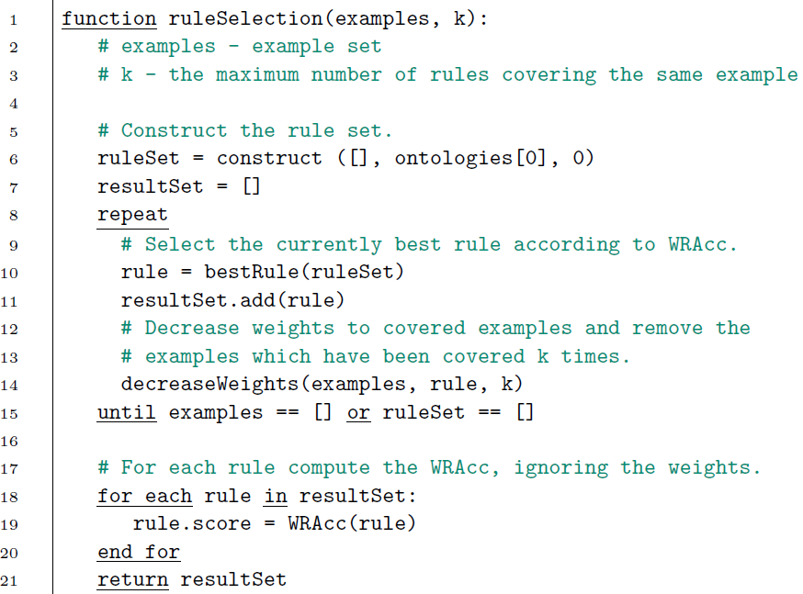
g-SEGS: rule selection

Slide 44
SDM-Aleph
An SDM system implemented using the popular ILP system Aleph ¹
Implemented as a WS in Orange4WS
Same inputs/outputs as g-SEGS
Any number of additional binary relations
¹ Ashwin Srinivasan http://www.cs.ox.ac.uk/activities/machlearn/Aleph/aleph.html

Slide 45
SDM-Aleph: rule construction and selection
Select example
Build a most specific clause for that example (bottom clause)
Search: from the bottom clause enumerate all more general clauses which satisfy some conditions (e.g., min support)
From the clauses select the best rule according to wracc and add it to the rule set
Go to 1

Slide 46
SDM-Aleph: implementation
For solving similar SDM tasks – convert:
  Ontologies, examples, example-to-ontology map
Concept c, with child concepts c1, c2, …, cm:
  c(X) :- c1(X) ; c2(X) ; … ; cm(X).
The k-th example, annotated by c1, c2, …, cm:
  instance(ik). c1(ik). c2(ik). … cm(ik).
Examples: ranked or labelled
  Transform into a two-class problem according to a threshold.
Additional relations:
  r(i1, i2). % extensional def. of r/2

Slide 47
Experimental datasets
Two publicly available bio microarray datasets
  ALL (Chiaretti et al., 2004)
  hMSC (Wagner et al., 2008)
Gene expression data
  ALL ~9,000 genes, hMSC ~20,300 genes
Background knowledge: Gene Ontology and KEGG
Elaborate preprocessing workflow (designed with biologists) -- see demo
Notes:
- Biologically meaningful

Slide 48
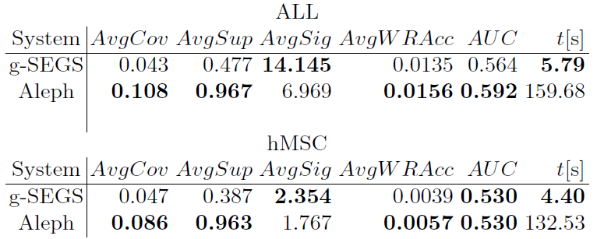
Experimental results
Comparison with SEGS: less and more diverse rules
Comparison with Aleph
  Evaluation: descriptive measures of rule interestingness (Lavrač et al., 2004)
  Less general and more significant rules, speed
Notes:
In the paper we describe how we encode the task in aleph
The same preprocessing steps were done before using aleph
At first we thought that more general rules are better
But after evaluation with a biology expert, it has turned out that more specific rules are much more interesting for them

Slide 49
Example subgroup description
‘RNA binding’ AND ‘ribosome’ AND ‘protein biosynthesis’
or
target(X) :- ‘RNA binding’(X), ‘ribosome’(X), ‘protein biosynthesis’(X)
Notes:
Molecular function, cellular component, biological process

Slide 50
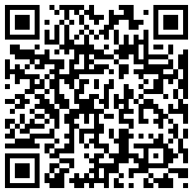
Demo
http://kt.ijs.si/anze_vavpetic/SDM/ecml_demo.wmv
Contact:
  { nada.lavrac, anze.vavpetic }@ijs.si

